Slide 1
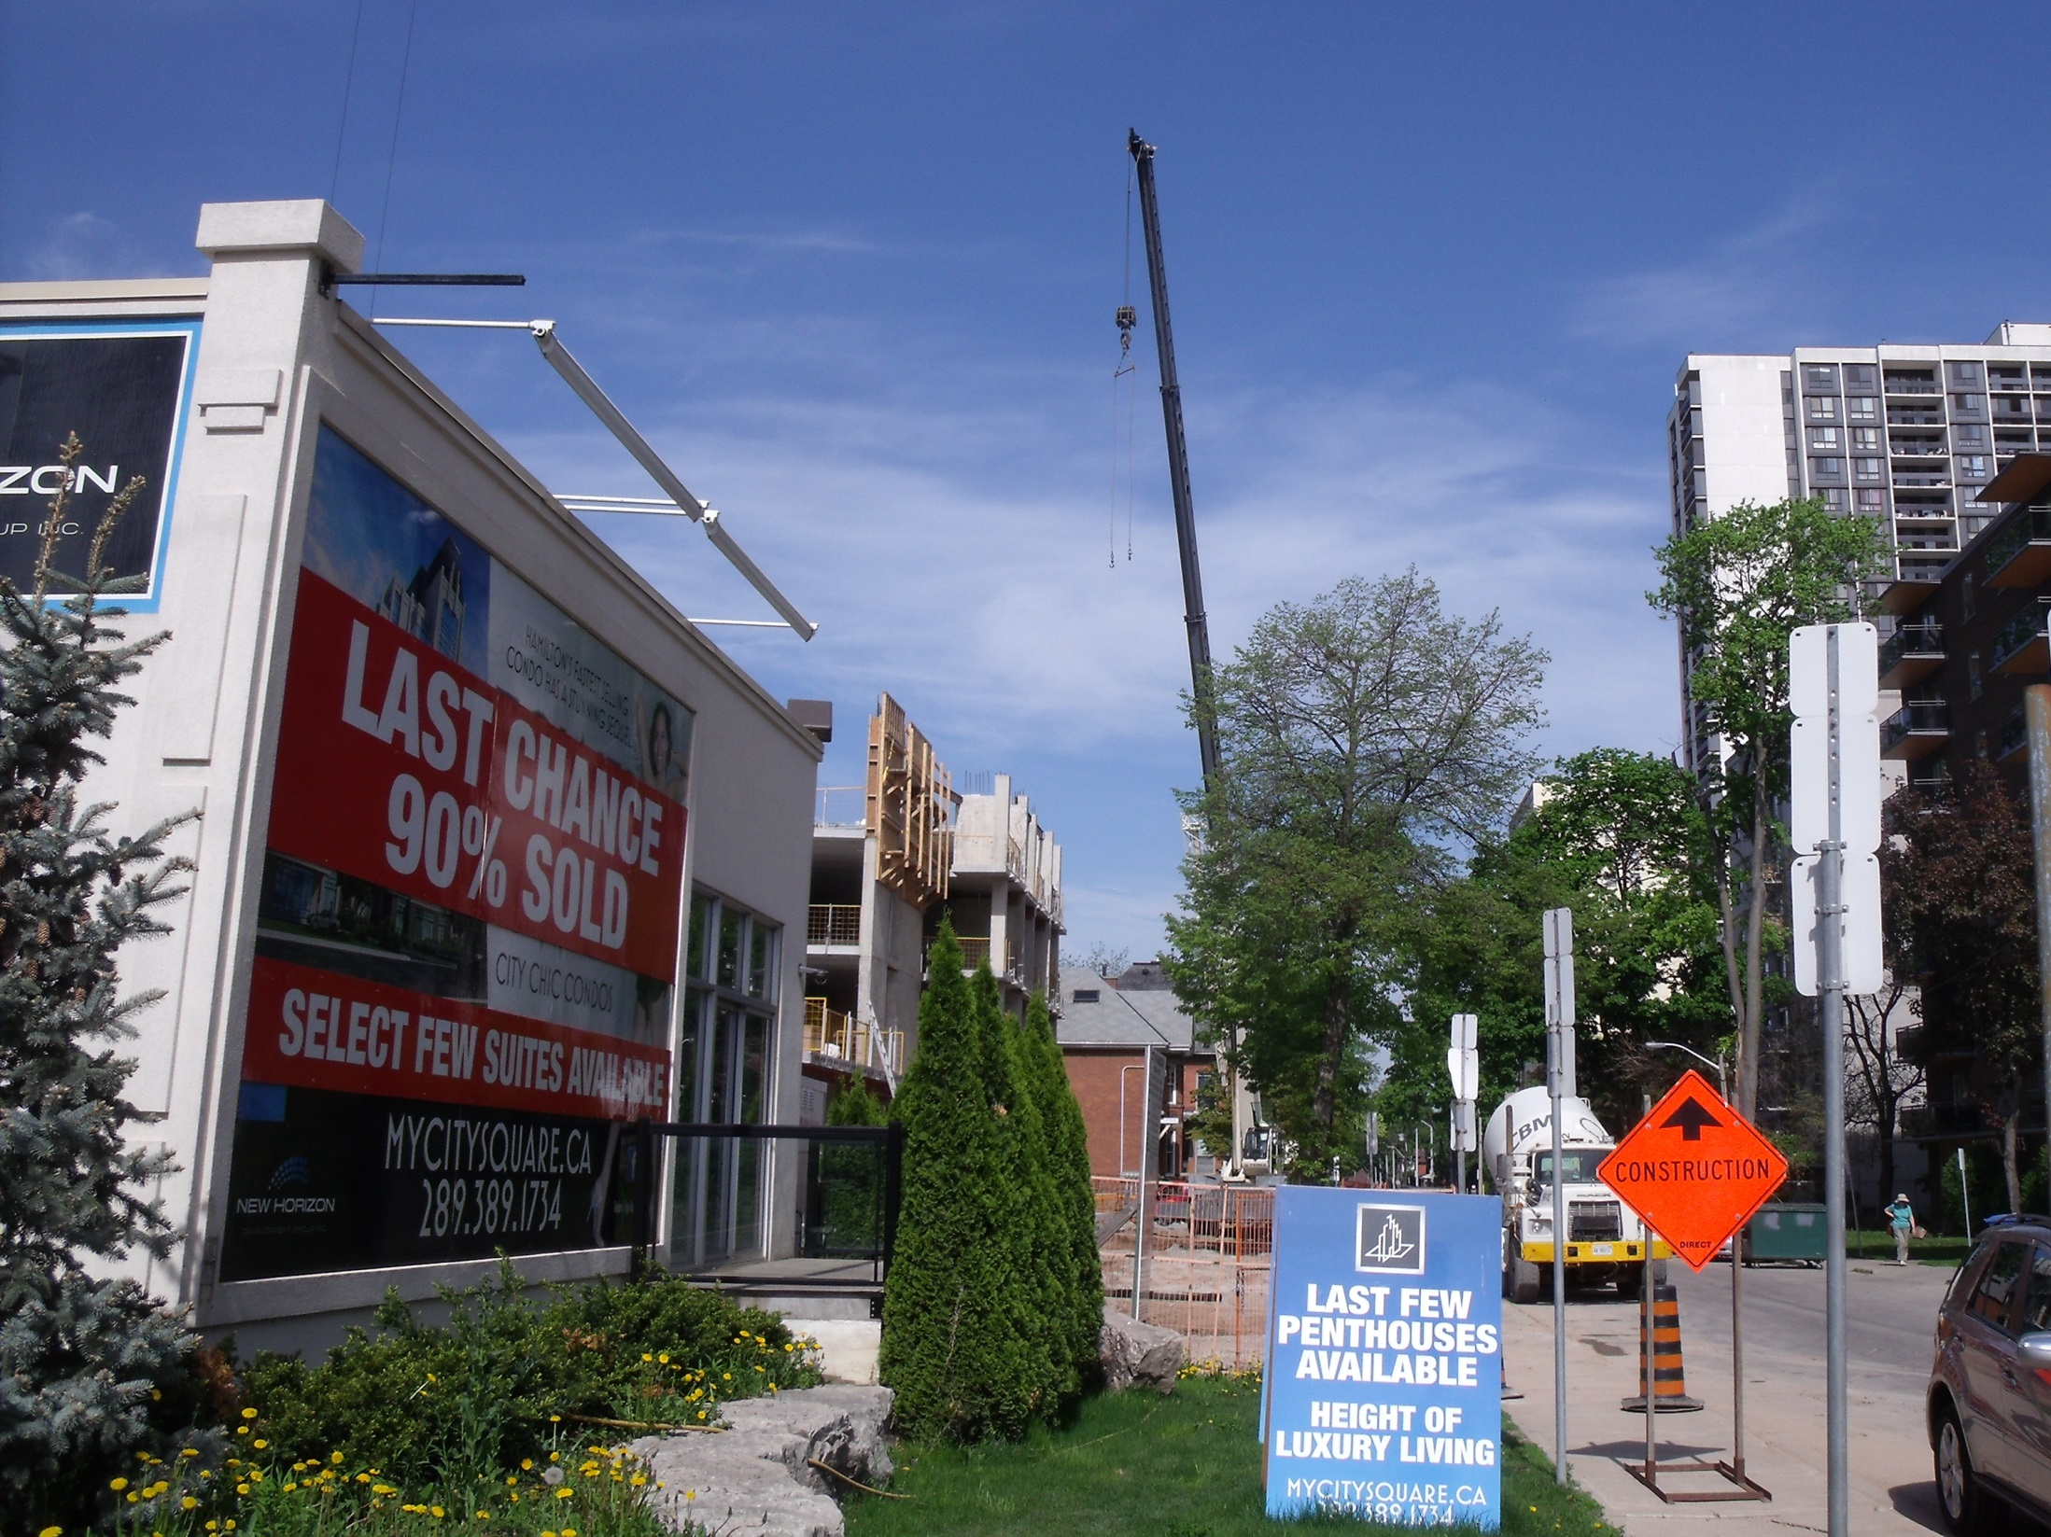
Modelling the Booms, Busts, and Futures of Housing in Canada
Presented by Eric Miller (Consulting Economist)
May 31, 2014 at the Canadian Economics Association Conference in Vancouver

Slide 2
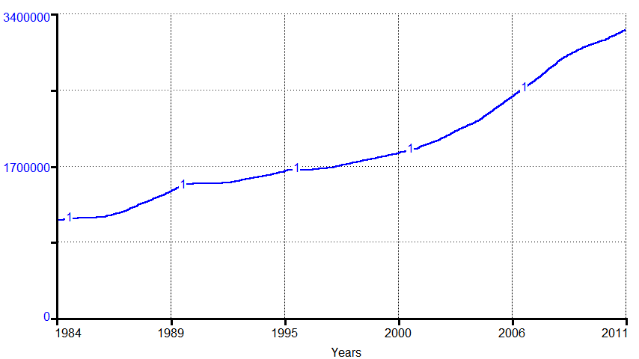
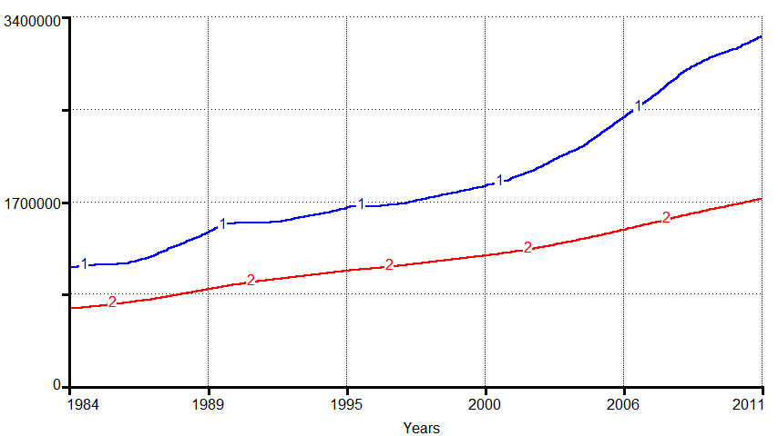
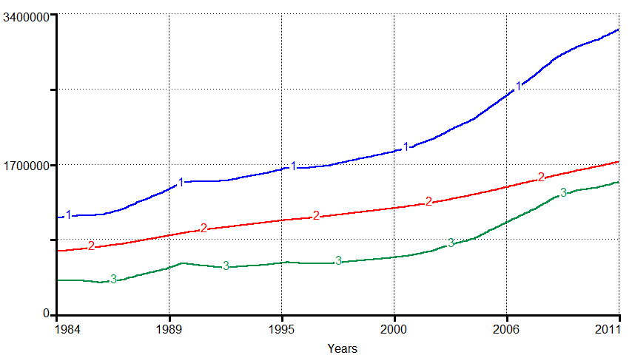
Housing value recorded on National Balance Sheet
1=Residential Capital
2=Residential structures
3=Residential land
$M CAD (2007)
Millions of people
Canadian population
Source: Statistics Canada (CANSIM Tables 051-0005, 030-0002, calculations from 378-0049, 378-0051, 326-0021)

Slide 3
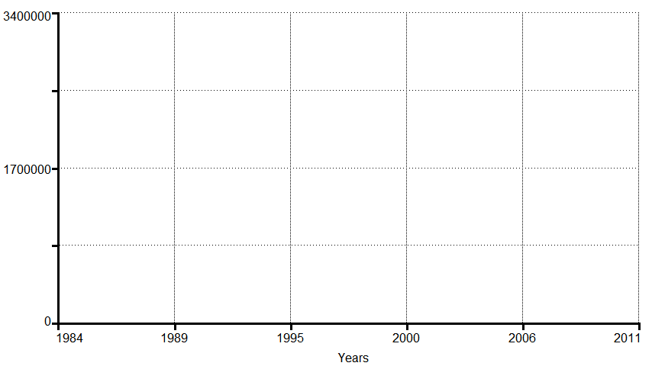
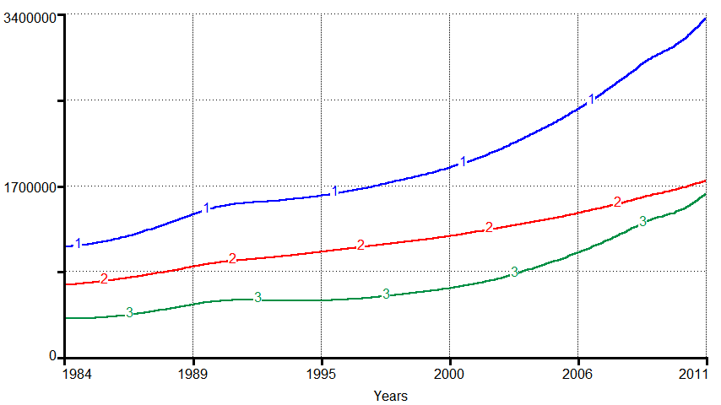
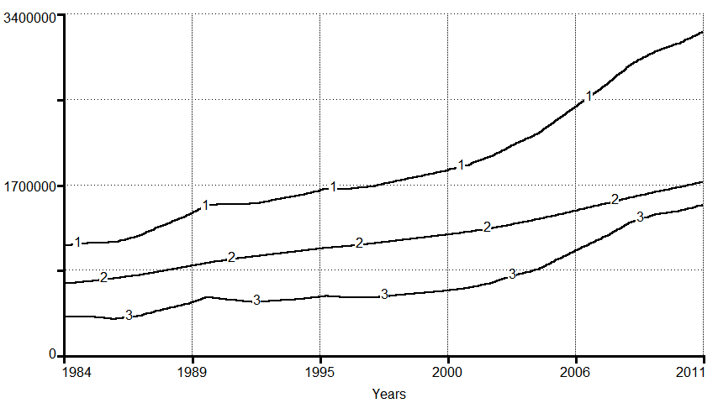
Housing value predicted by model
1=Residential Capital
2=Residential structures
3=Residential land
$M CAD (2007)
(Knowing actual trends in: Demographics , Employment, Household Income, Avg mortgage rate)

Slide 4
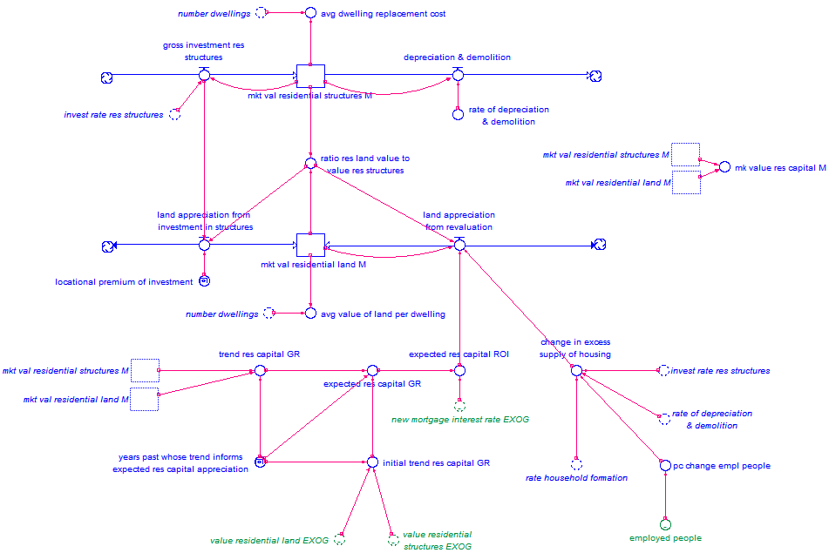
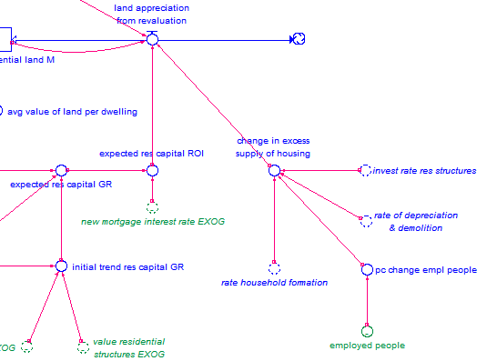
How residential structures and land are modelled

Slide 5
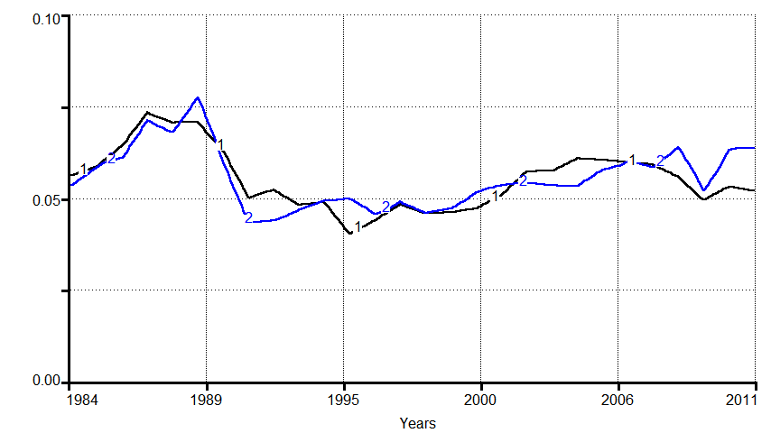
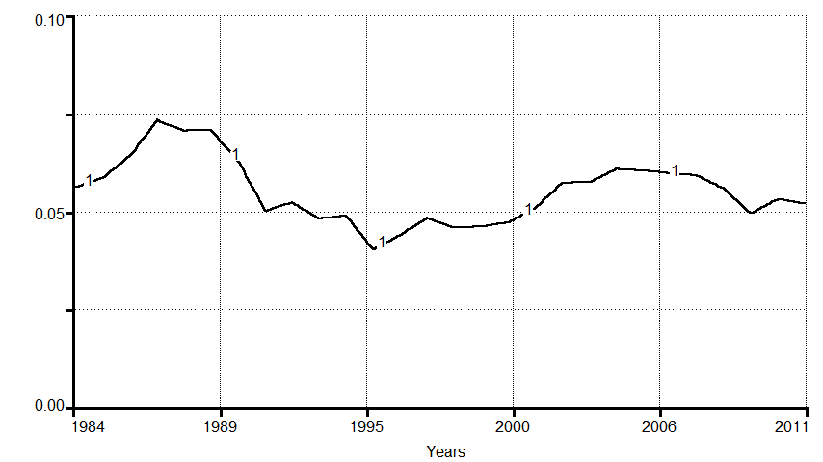
Actual vs Modelled investment in residential structures
1=Actual rate of investment in residential structures
2=Modelled rate
Annual Rate
Source for actual rate: Statistics Canada (CANSIM Table 030-0002)

Slide 6
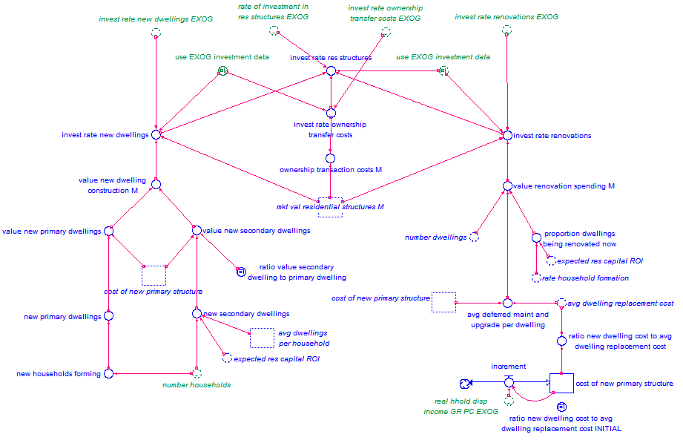
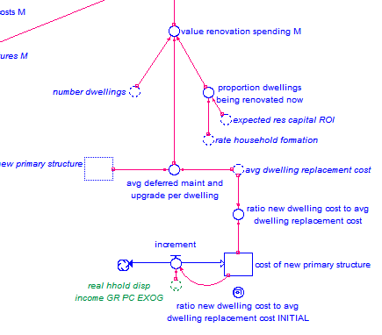
How investment in residential structures is modelled

Slide 7
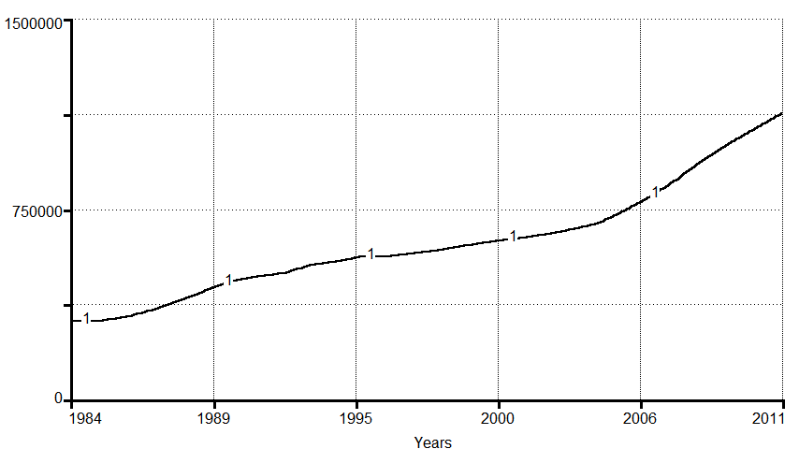
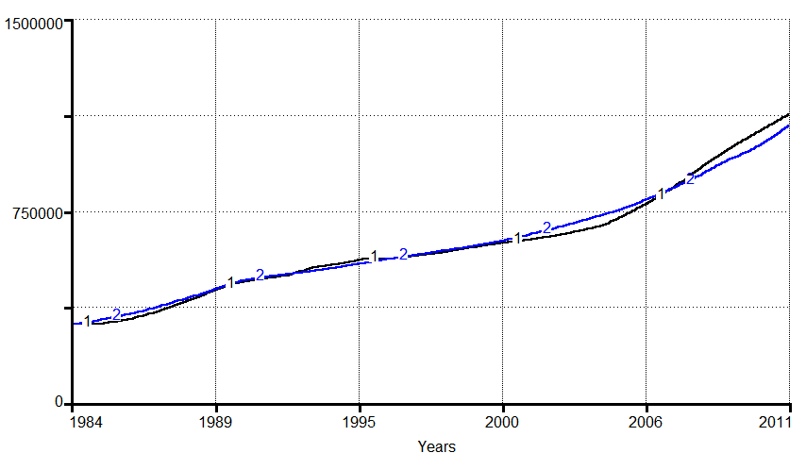
Actual vs Modelled stock of outstanding mortgages
1=Value of outstanding residential mortgage debt
2=Modelled value
$M CAD (2007)
Source for actual nominal stock of mortgages: Statistics Canada (CANSIM Table 378-0049 modified by 326-0021)

Slide 8
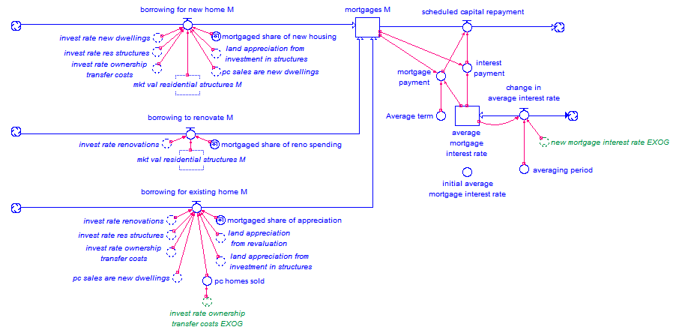
How the supply of mortgage debt is modelled

Slide 9
How the model helps to understand housing in Canada
What fuels growth in residential dwellings?
What fuels change in residential land values?
How much have “animal spirits” affected housing values?
What share of investment and revaluation is financed by credit?
Is there an “equilibrium” that helps to define “bubbles”?
What could happen in the future?

Slide 10
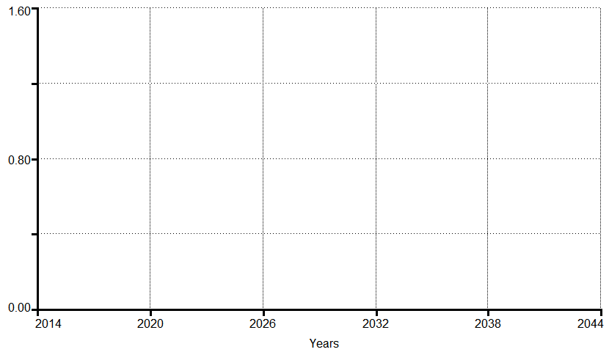
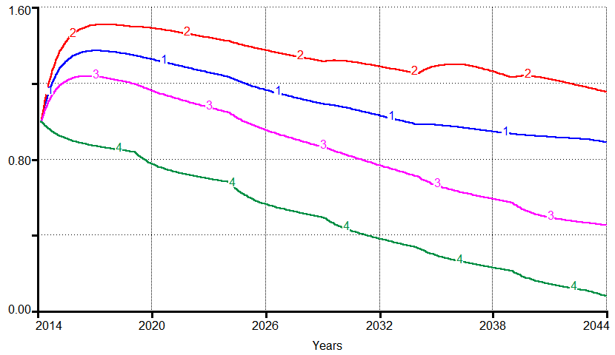
Anticipating Canada’s housing futures
Percent growth in units needed to house newly formed households (based on demographics alone)
1 = Medium population growth 2 = High growth 3 = Low growth 4 = Stabilization (peaking in 2035)

Slide 11
Concluding messages
System dynamics modelling is useful for understanding many important macro-economic aspects of Canada’s housing market.
Canadian history of housing investment, land prices, and mortgage debt are affected by the interaction of demographics, employment, income, interest rates.
Feedbacks within the housing system keep it dynamic without any apparent tendency towards “an equilibrium.”
The Canadian policy community should seek to better understand the dynamics of housing in order to hep strategize whether and how to affect Canada’s housing market.

Slide 12
References and Acknowledgements
All referenced Statistics Canada data are from CANSIM (2014).
Thanks to staff at Statistics Canada for answering data-related questions.
Thanks to the University of Surrey’s Centre for Environmental Strategy for sponsoring my transportation to Vancouver to present this at CEA 2014.
Thanks to the Institute for New Economic Thinking (INET) for funding me to develop the demographic part of this model, in support of a research project led by Peter Victor and Tim Jackson.
Carbon emission attributed to me flying to this conference were offset with gold standard offsets from Offsetters.ca.
For additional information, please contact me at www.h4x.ca.

